Slide 1
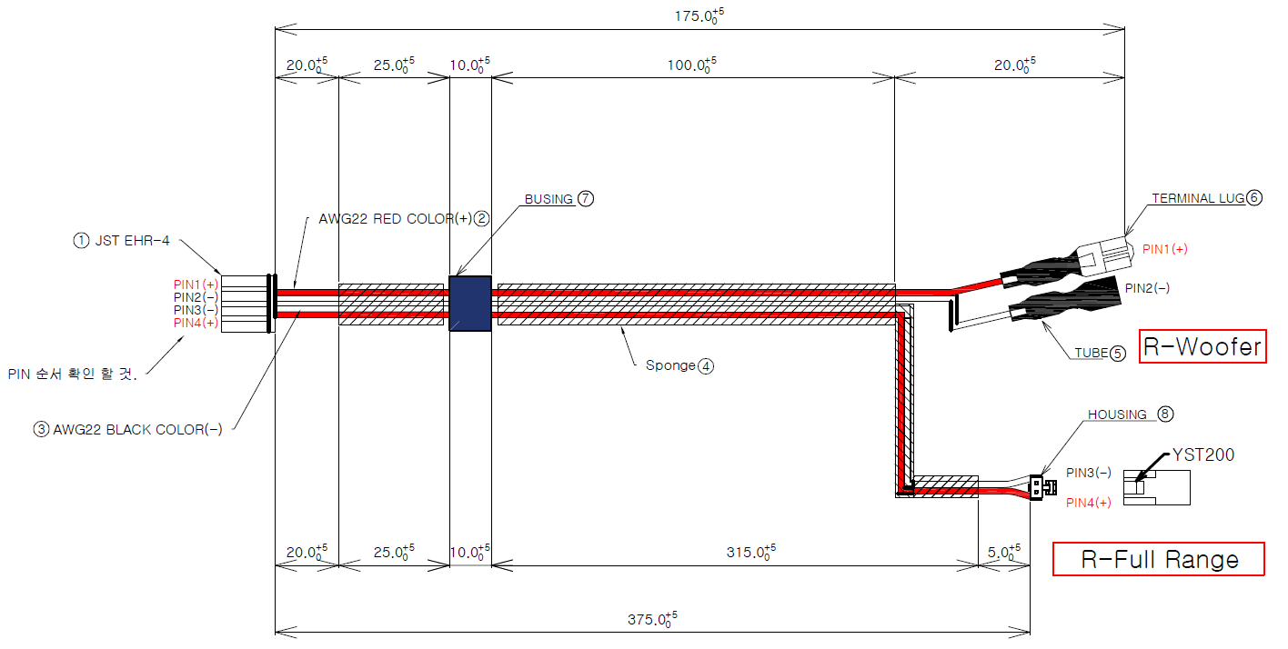
CABLE_SPEAKER_CORD_ASSY_right
265mm

Slide 2
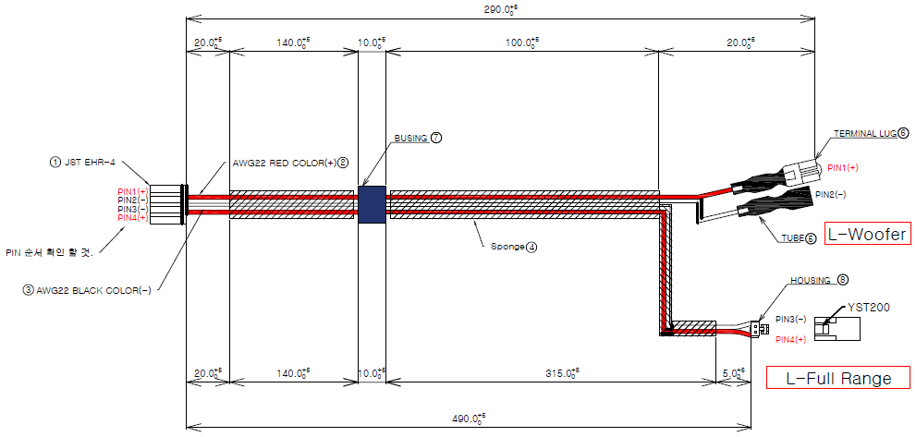
CABLE_SPEAKER_CORD_ASSY_left
265mm

